Slide 1





Google Summer of Code
GSOC 2025 LIGHTNING TALK
presented by Shubham Vishwakarma

Slide 2

Who Am I?
👋 Hi, I’m Shubham Vishwakarma from Mumbai, India.
Final-year CSE student at SPIT, with a Management minor at SPJIMR.
Open Source Contributor with Scala Center (GSoC 2025).
My Scala journey began with Rock the JVM courses, which sparked my passion and connected me to this welcoming community.
Shubham Vishwakarma
India 🇮🇳
Notes:
“Hi, I’m Shubham from Mumbai, India.
I’m a final-year Computer Science student at SPIT, with a management minor at SPJIMR, and currently an open-source contributor with Scala Center through GSoC 2025.
My Scala journey began with Scala Center’s Rock the JVM courses, which made me fall in love with the language and led me into this supportive community.”

Slide 3

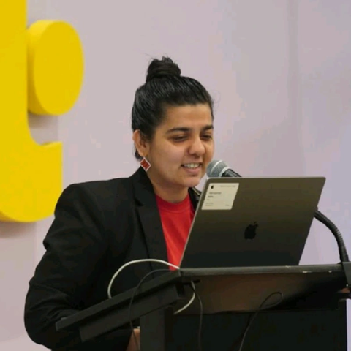
Discovering GSoC & Scala Center
Came across GSoC with Scala Center and found LLM4S, the perfect blend of Scala and AI.
Mentorship from Kannupriya Kalra & Rory Graves made the journey real and guided my direction.
The challenge was clear: LLM apps are hard to debug, observe, and scale.
Our mission: Make Scala a first-class citizen in AI tooling, built on type safety and FP principles.
Rory Graves
Kannupriya Kalra
Notes:
“I came across GSoC with Scala Center and found LLM4S — the perfect mix of Scala and AI.
With guidance from Kannupriya Kalra, Rory Graves, and later Dmitry Mamonov, my curiosity turned into meaningful contributions.
The challenge was clear: LLM apps are hard to debug, observe, and scale.
Our mission: make Scala a first-class citizen in AI tooling with type safety and functional programming principles.”

Slide 4
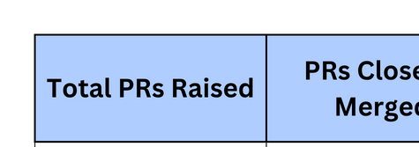
From First Trace to Full Demo: My Contributions
Tracing Support (PR #77, #119) :
Added execution flow tracking, spans, and timing.
Integrated Langfuse for developer-friendly traces.
Type-Safe Tracing (PR #165) :
Rebuilt with sealed traits & composable backends.
Ensured reliability and backward compatibility.
Demo & Multi-Backend (PR #184) :
Built a calculator agent for sequential tool-use.
Showcased tracing with Console, Lang fuse, and NoOp.
Notes:
“My contributions followed a path:
PRs #77 and #119 added tracing support with spans, timing, and Langfuse integration.
PR #165 rebuilt tracing with sealed traits and composable backends for type safety.
PR #184 showcased it all in a demo agent — tool chaining with multi-backend tracing.
So it went from first trace → type-safe system → full working demo.”

Slide 5
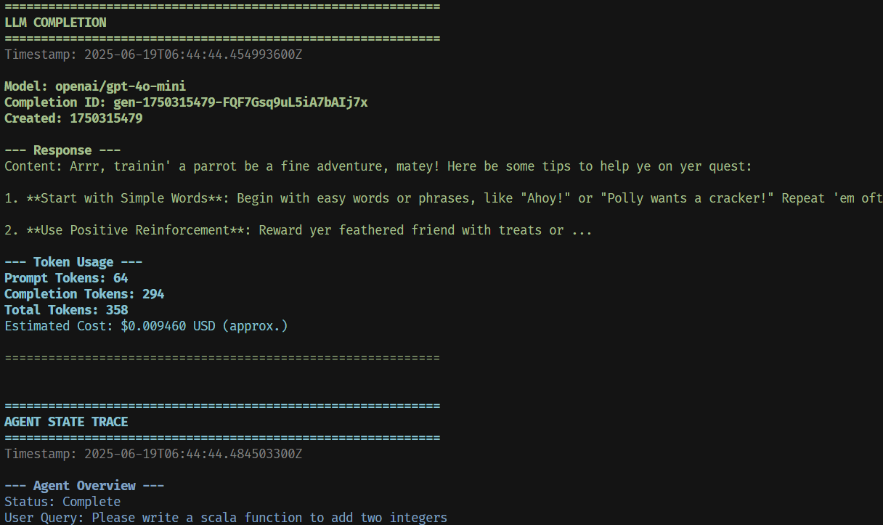
Why It Matters : The Impact
Visibility Unlocked : Developers can now trace every LLM call
Type-Safe Reliability : Sealed traits & composable backends remove fragile logging
Real-World Proof : Demo agent + multi-backend tracing shows it works in practice .
Future-Ready : Establishes the base for memory, multi-agent orchestration, and Scala-first AI systems.
Image : Print Trace Example
Notes:
Why It Matters
“This work gives developers visibility inside their LLM apps: what was called, when, and why it failed.
Type safety makes it reliable, and the demo proves it’s practical.
It also lays the foundation for memory, typed DSLs, and multi-agent orchestration.”

Slide 6
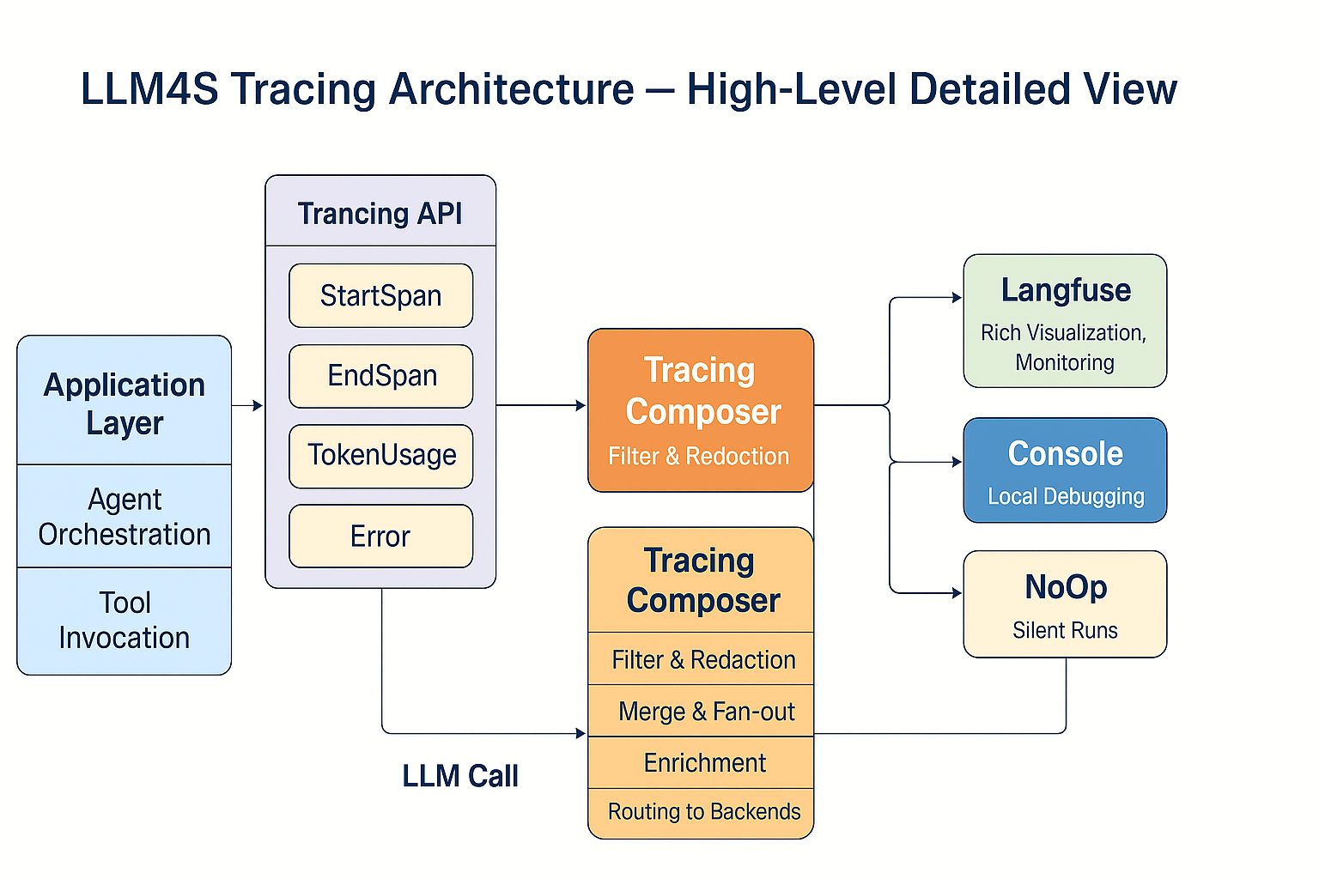
Image : LLM4S Tracing Architecture

Slide 7
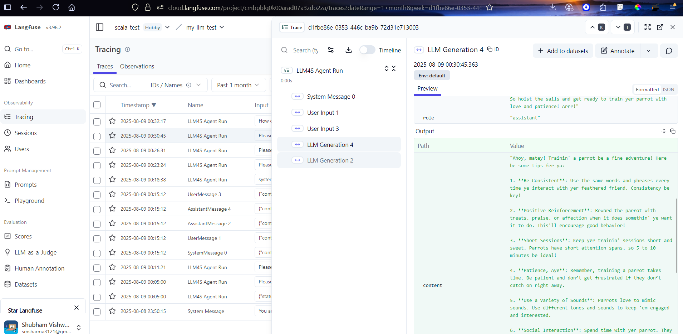
Image : Langfuse Tracing Example

Slide 8

Beyond Tracing: The Next Chapter for LLM4S
Multi-Agent Systems :🔄 In Progress
DAG-based planner with retries & fallbacks.
Pub-sub signals for safe agent coordination.
Scala-native, type-safe orchestration.
Typed Prompt DSL : ⏳ Planned
Scala DSL for chaining LLMs, retrievers, tools.
Cats-effect & typed streams for composability.
Compile-time safety, no “stringly-typed” prompts.
Notes:
My next focus is expanding LLM4S beyond tracing:
Multi-Agent Systems (in progress): DAG planner, retries, fallbacks, pub-sub signals, and agent state handling.
Typed Prompt DSL (planned): a Scala-native DSL for chaining LLMs, retrievers, and tools, with compile-time safety.
Memory & State (planned): hybrid short-term, episodic, and semantic memory with forgetting strategies.
Together, these transform LLM4S into a platform for adaptive, reliable AI systems.”

Slide 9
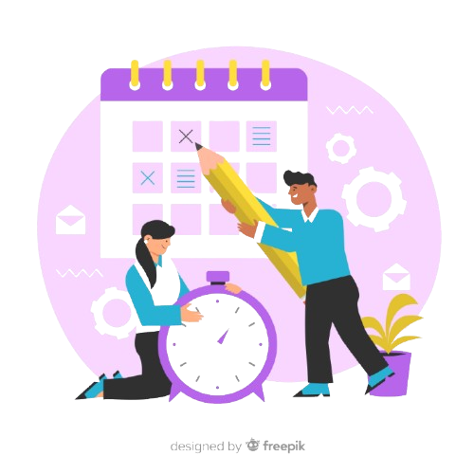
A Real Use Case : Meeting Minutes Generator ⏳ Planned
Input : Zoom / Google Meet transcript (raw text).
Output:
→ Concise summary of discussion
→ Action items with owners & deadlines
→ Sentiment analysis of conversation flow
Why LLM4S?
→ Streaming summaries (real-time insights as the meeting runs)
→ Guardrails via JSON schema → {summary: String, actions: [Action]}
→ Full traceability → every step tracked with spans/events
Notes:
“Imagine finishing a one-hour Zoom call and instantly getting a summary, action items with owners, and sentiment analysis.
With LLM4S, this is possible — streaming summaries, JSON guardrails for structured output, and full traceability.
Meetings end with clarity, not chaos.”

Slide 10
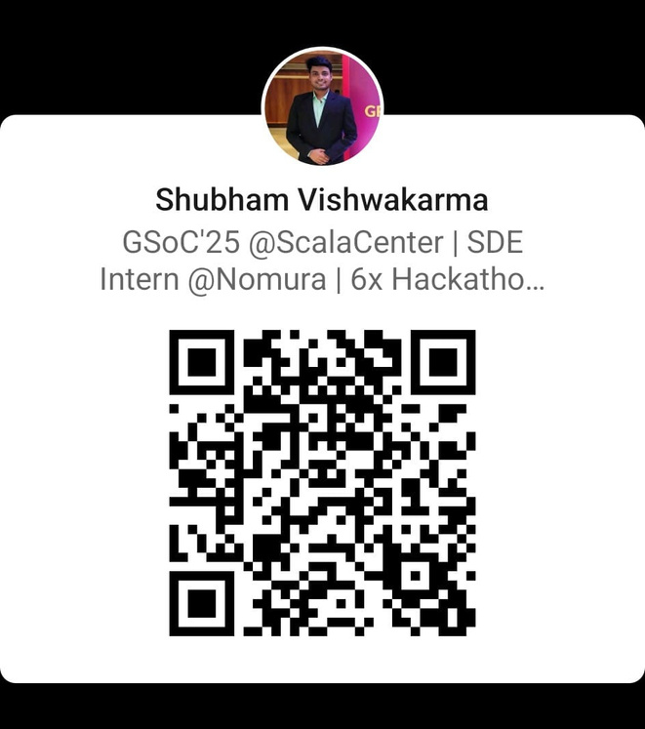
THANK YOU
From learner to contributor → grateful for this journey with Scala.
Heartfelt thanks to my mentors Kannupriya Kalra, Rory Graves & Dmitry Mamonov, and the Scala Center.
💙 To the Scala community for being supportive, curious, and inspiring.
Connect with me :)
Notes:
“This journey has been transformative. From learning Scala through Scala Center’s courses to contributing to LLM4S and presenting here today, I’ve grown as a developer and as part of this community.
I want to sincerely thank my mentors — Kannupriya Kalra, Rory Graves, and Dmitry Mamonov — for their guidance, and the Scala Center for creating this opportunity.
And most of all, thank you to the community — for being open, supportive, and inspiring.
For me, this is not an end — it’s the beginning of Scala’s role in the AI era.”
“Thank you. It’s been an honor to share my journey, and I’m excited to keep building Scala’s future in AI with you.”

